Slide 1
ELEC5566M FPGA Design for System-on-Chip
Unit 1.2 Task Review
Unit 2
Prof Steven Freear Module Leader s.freear@leeds.ac.uk
Dr David Cowell

Slide 2
Assignment 1 Engagement Update
Out of 146 Students!
58 Created Assignment 1 Repository in GitHub 31 Committed code
Deadline in 1 week!

Slide 3
Unit 1.2 Task Review

Slide 4
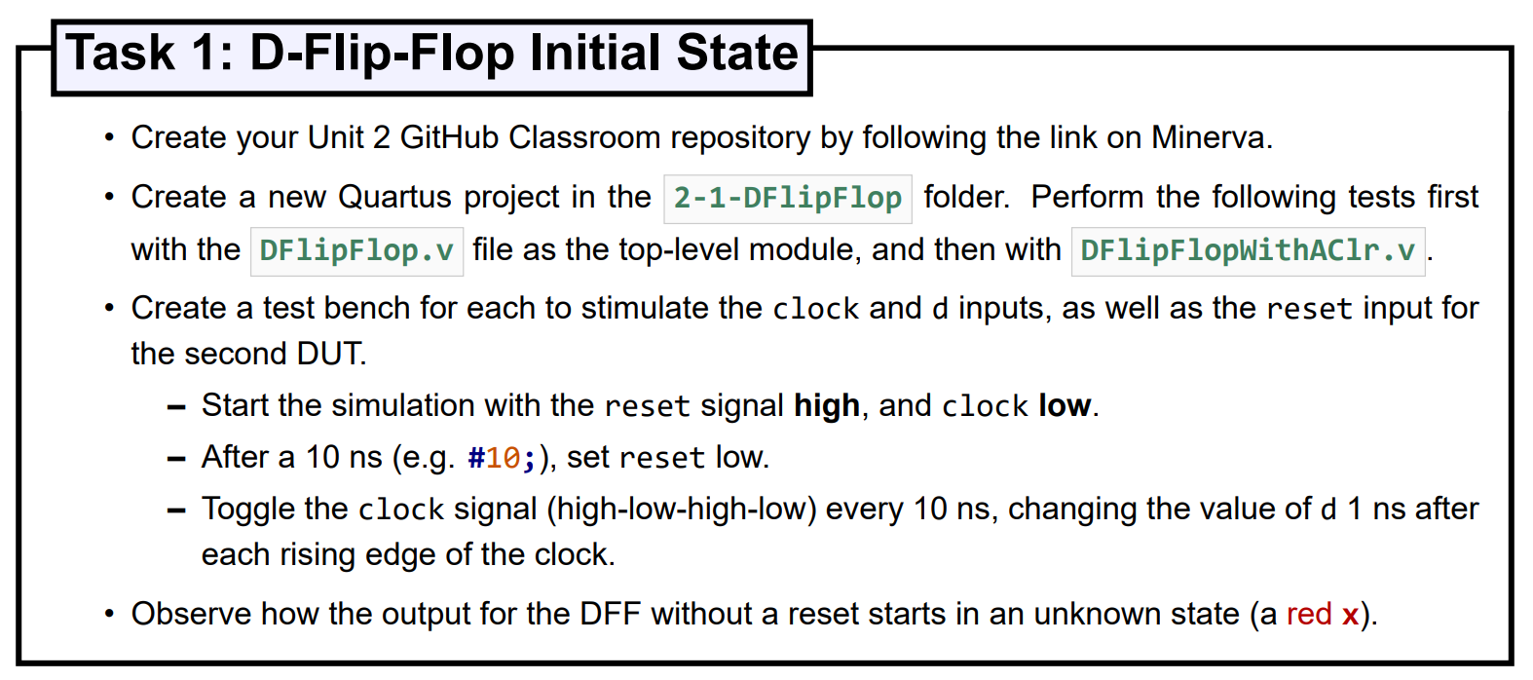
Task 1: D-Flip-Flop Initial State

Slide 5
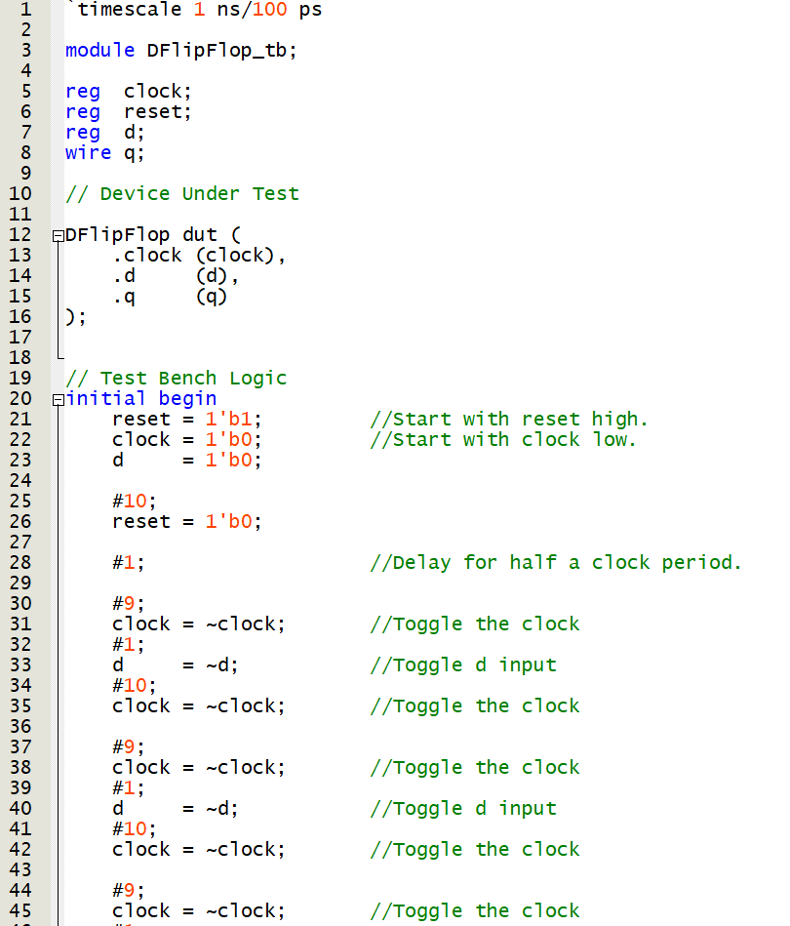
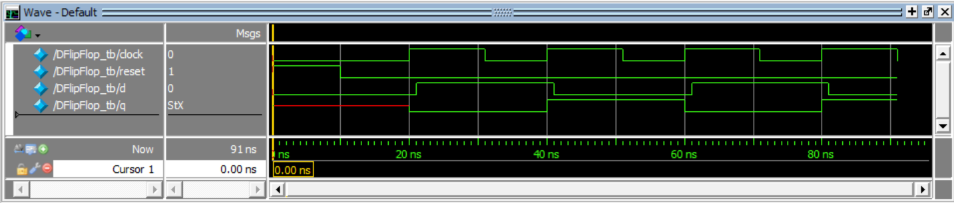
Task 1: D-Flip-Flop Initial State
Observe how the output for the DFF without a reset starts in an unknown state (a red x).
DUT has no reset – even though reset present in test bench!

Slide 6
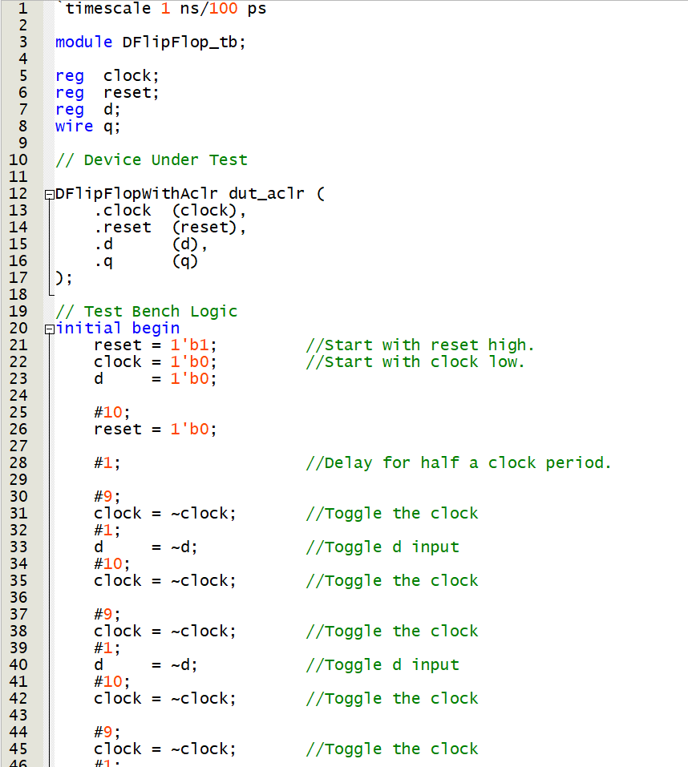
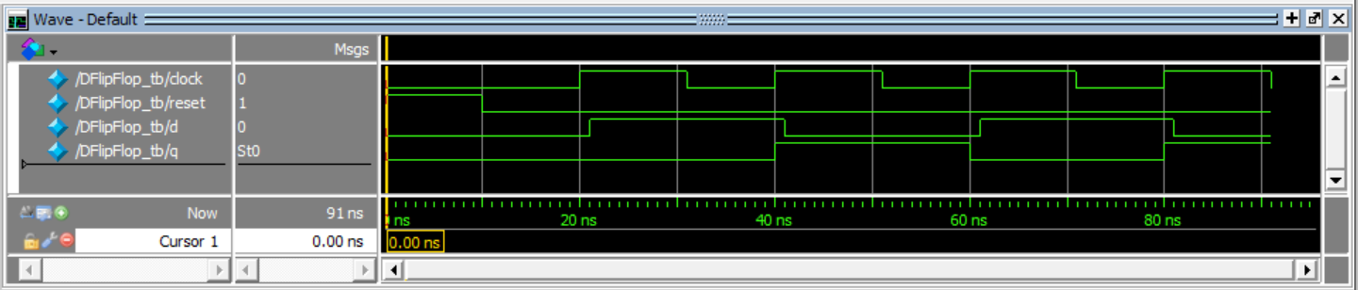
Task 1: D-Flip-Flop Initial State
Observe how the output for the DFF with a reset starts in a known state (low).

Slide 7
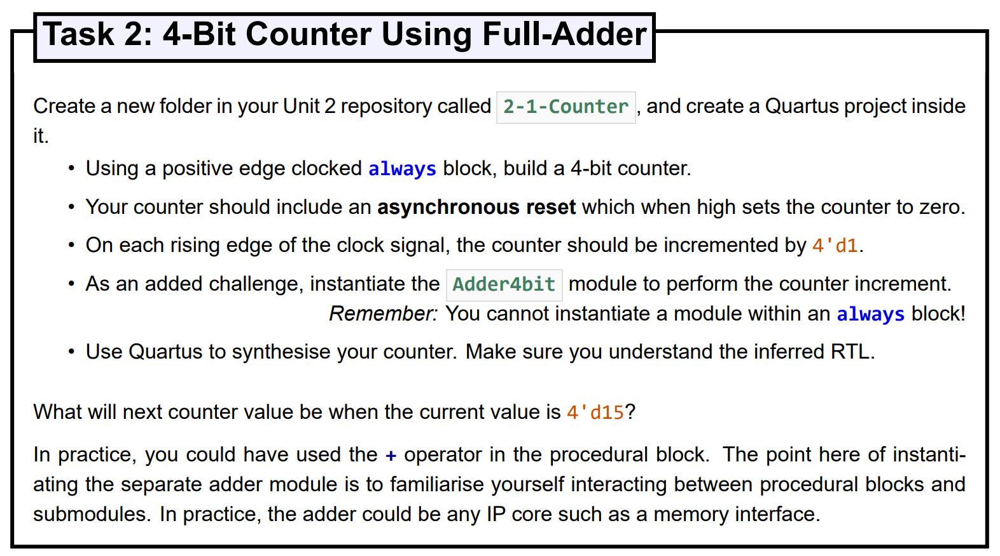
Task 2: 4-Bit Counter Using Full-Adder

Slide 8
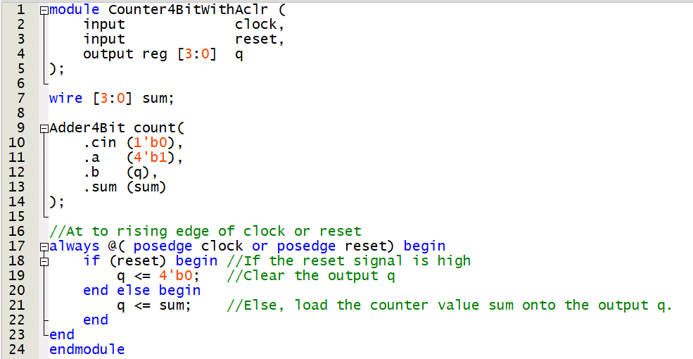
Task 2: 4-Bit Counter Using Full-Adder Verilog Code

Slide 9
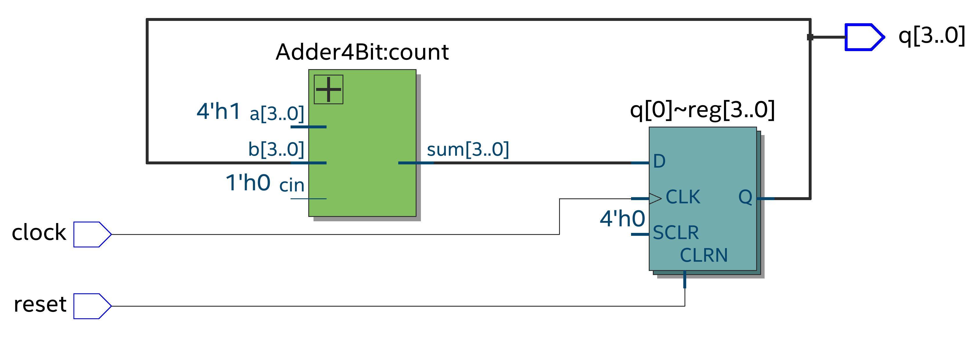
Task 2: 4-Bit Counter Using Full-Adder RTL Output

Slide 10
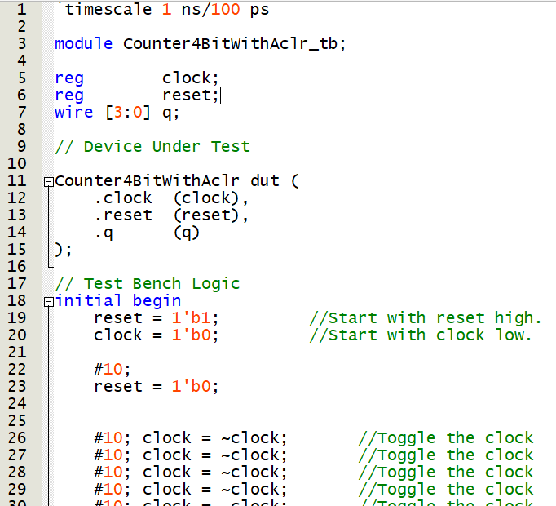
Task 2: 4-Bit Counter Using Full-Adder Verilog Code with Testbench

Slide 11
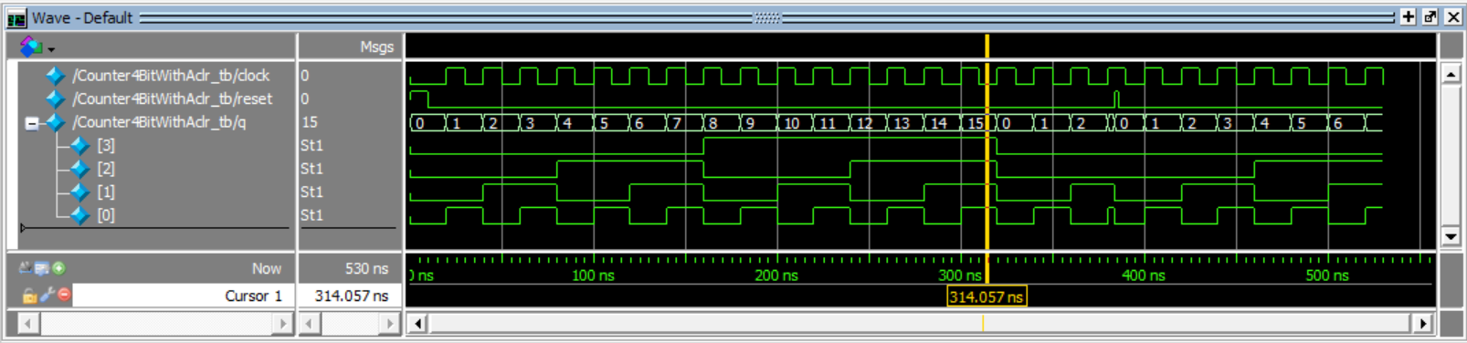
Task 2: 4-Bit Counter Using Full-Adder Testbench output waveforms
Max value of 15
Overflow to 0
Reset
Reset to 0

Slide 12
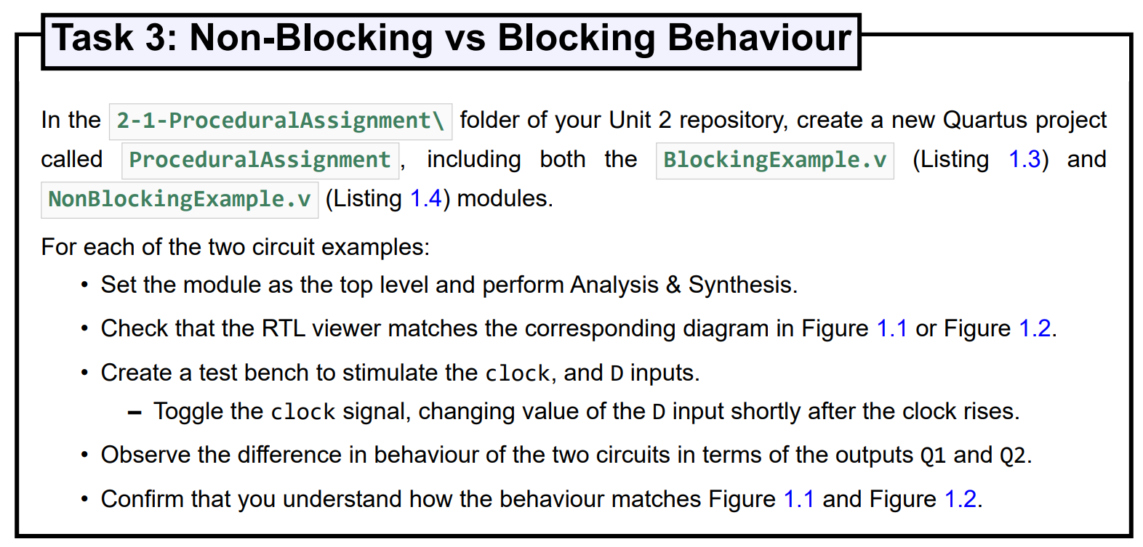
Task 3: Non-Blocking vs Blocking Behaviour

Slide 13
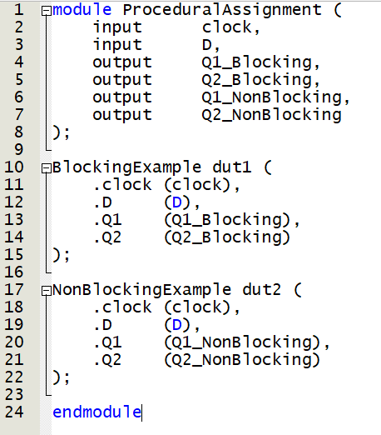
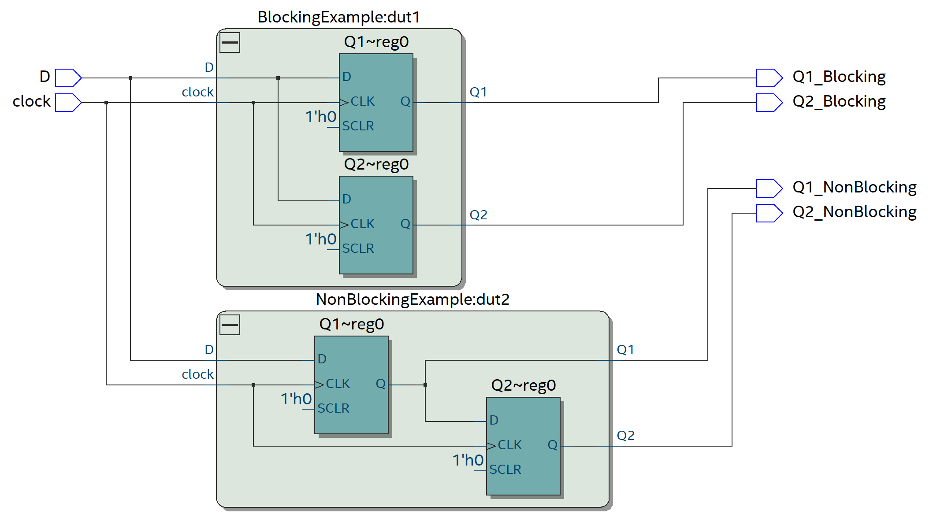
Task 3: Non-Blocking vs Blocking Behaviour Instantiate modules & RTL Viewer Output

Slide 14
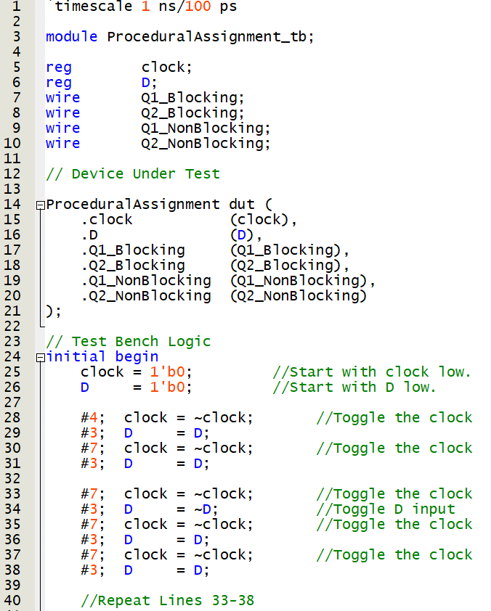
Task 3: Non-Blocking vs Blocking Behaviour Create test bench

Slide 15
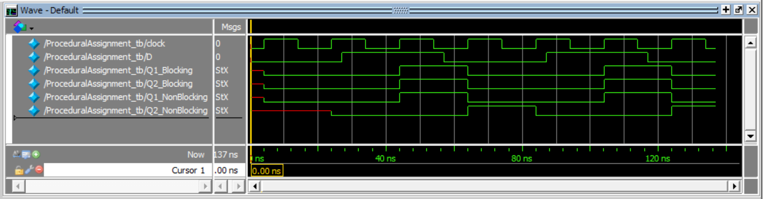
Task 3: Non-Blocking vs Blocking Behaviour Instantiate modules & RTL Viewer Output

Slide 16
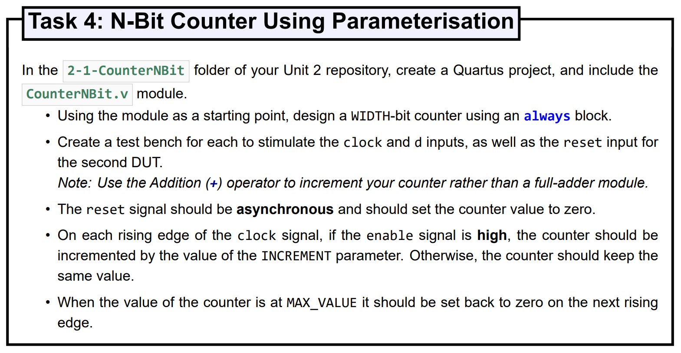
Task 4: N-Bit Counter Using Parameterisation

Slide 17
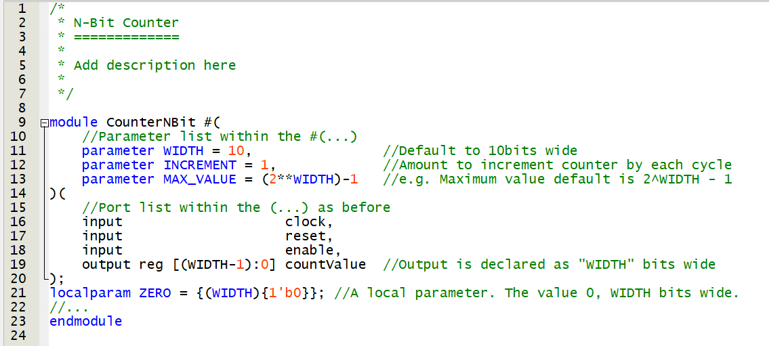
Task 4: N-Bit Counter Using Parameterisation Provided Code

Slide 18
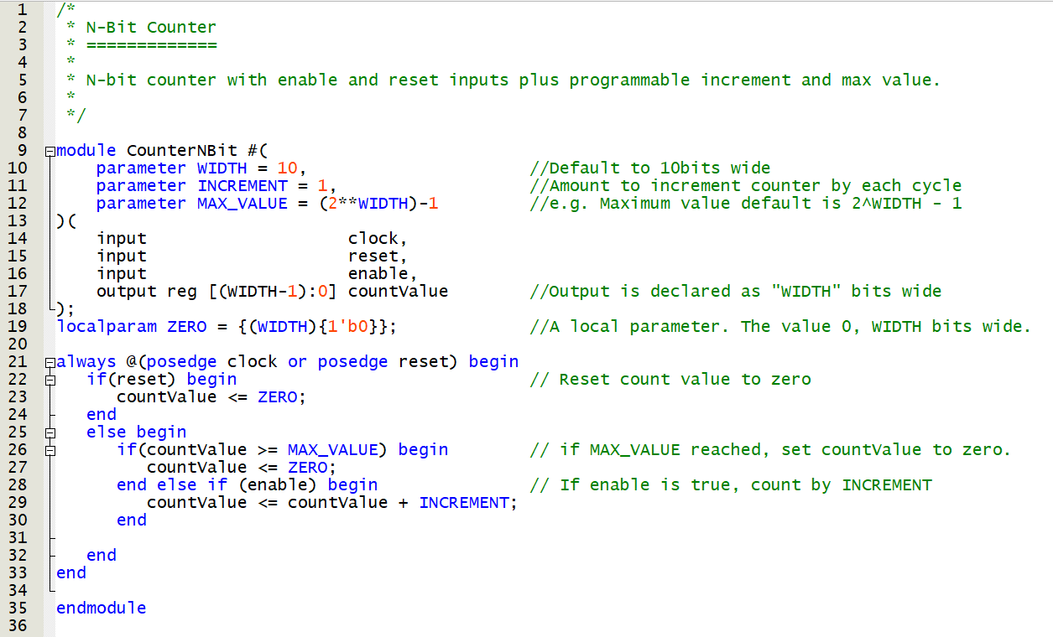
Task 4: N-Bit Counter Using Parameterisation One Possible Solution Code

Slide 19
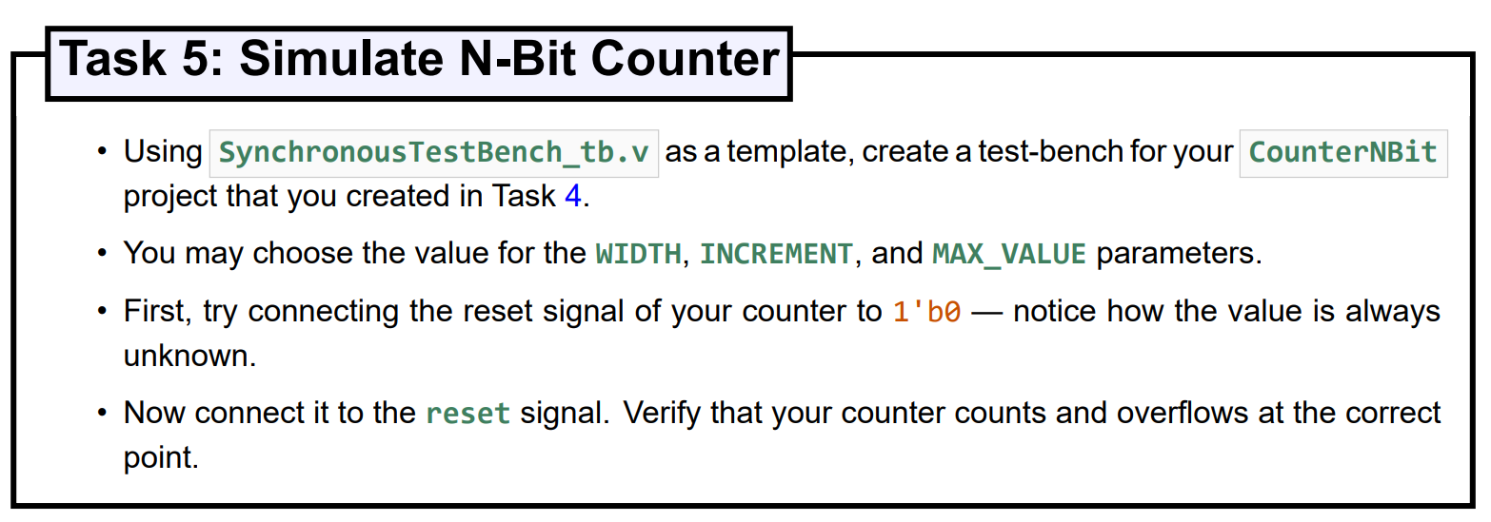
Task 5: Simulate N-Bit Counter

Slide 20
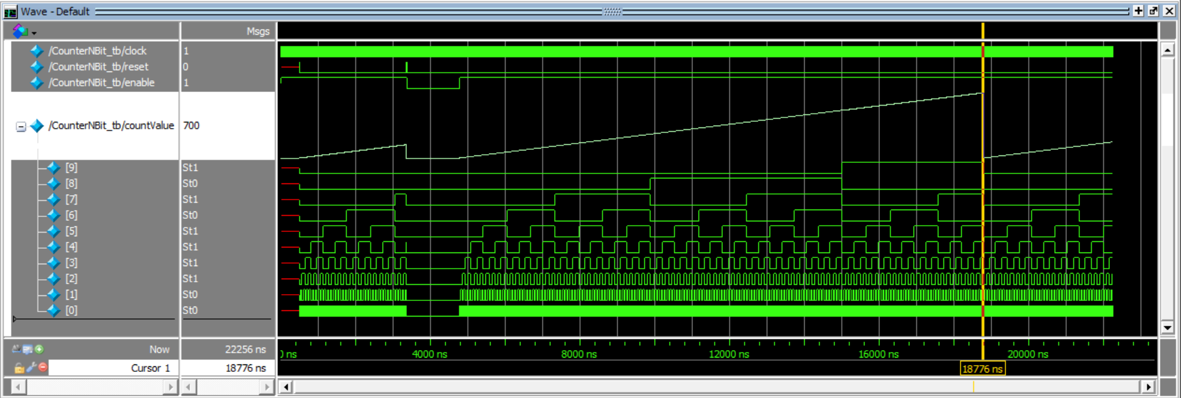
Task 5: Simulate N-Bit Counter
Undefined
countValue
until reset
countValue zero
on reset
enable
low
countValue >= MAX_VALUE
countValue reset to zero

Slide 21
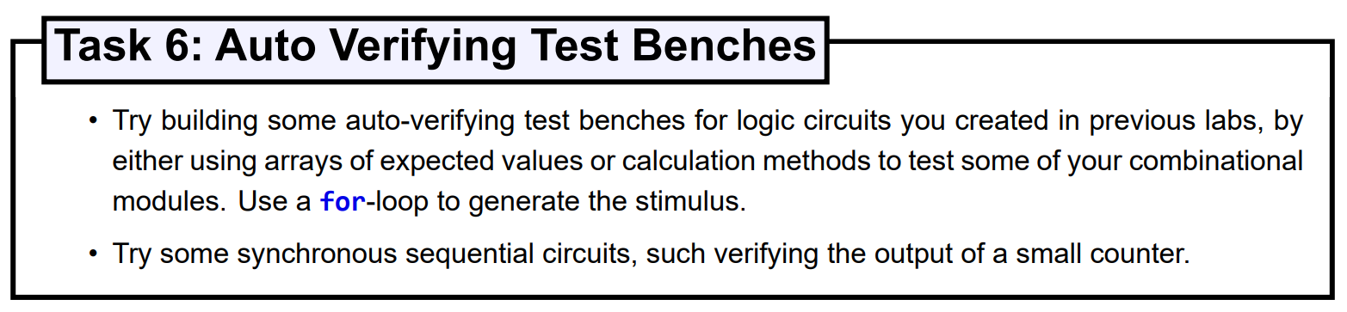
Task 6: Auto Verifying Test Benches

Slide 22
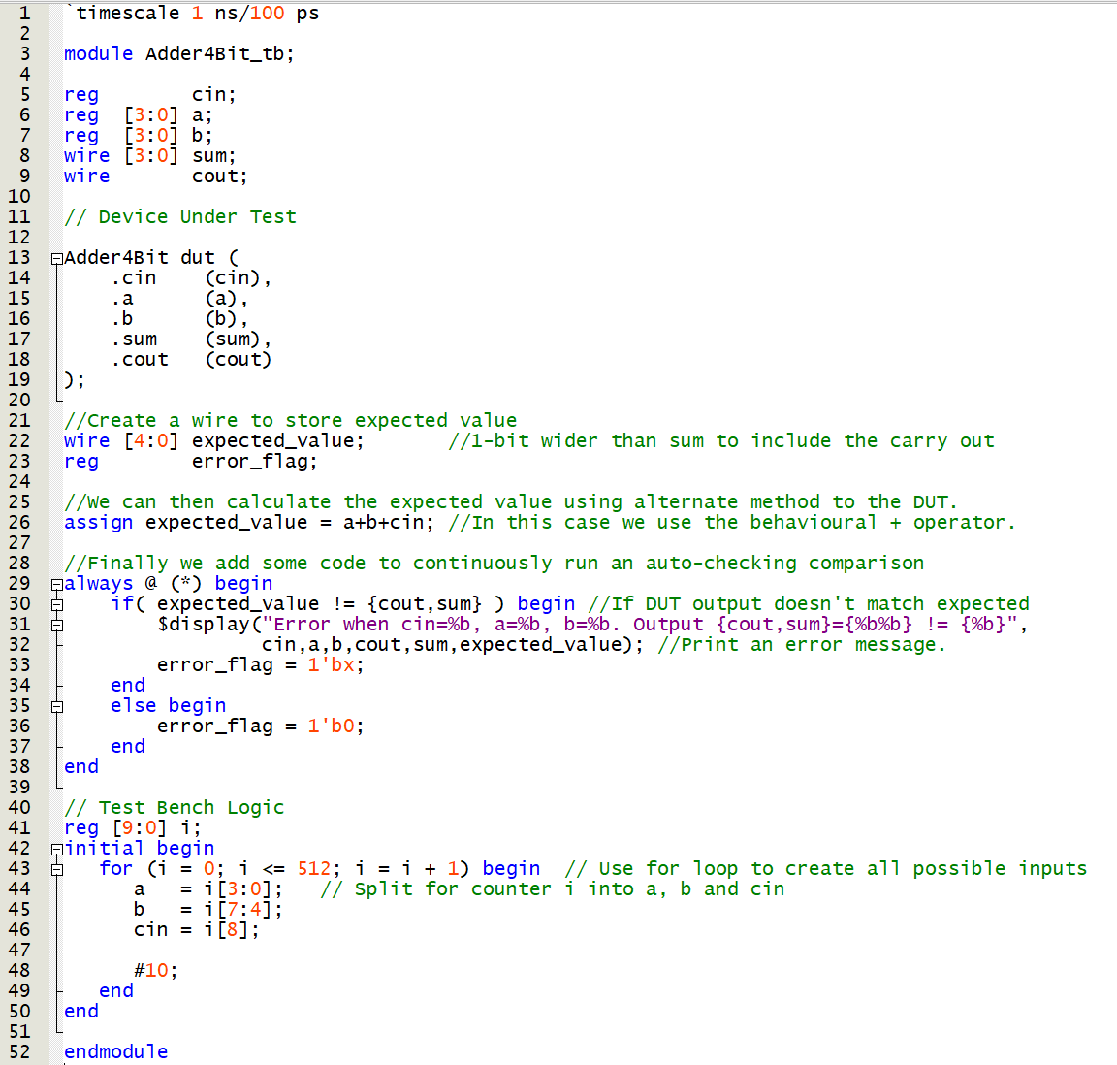
Task 6: Auto Verifying Test Benches Adder4Bit
Registers (for DUT inputs) and wires (for DUT outputs)
Device Under Test (DUT)
Calculate the expected value
Display when expected value and DUT output are not equal.
Set error_flag to X to show red in waveforms.
For loop to calculate all possible inputs (512 in total)
Split counter i for inputs to DUT

Slide 23
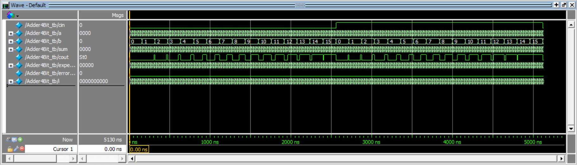
Task 6: Auto Verifying Test Benches Adder4Bit
Adder4Bit working perfectly – no errors flagged!

Slide 24
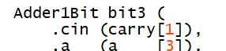
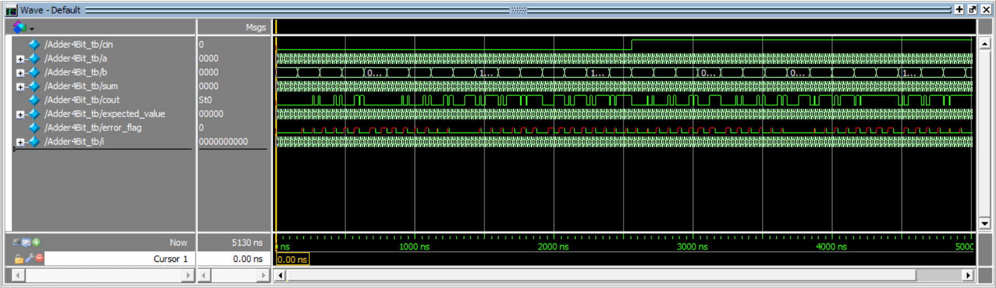
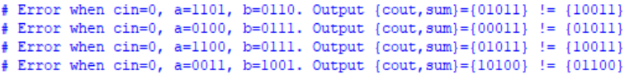
Task 6: Auto Verifying Test Benches Adder4Bit
Break Adder4Bit to demonstrate error detection! cin should be carry[2]!

Slide 25
Unit 2.2: Synchronous Logic
Finite State Machines

Slide 26
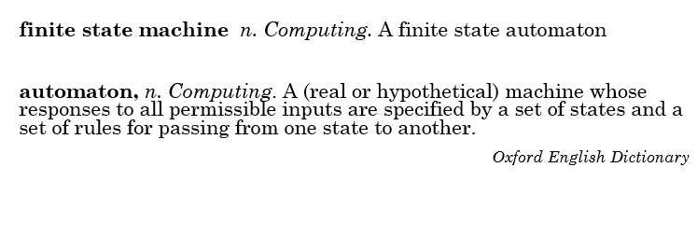
Finite State Machine

Slide 27
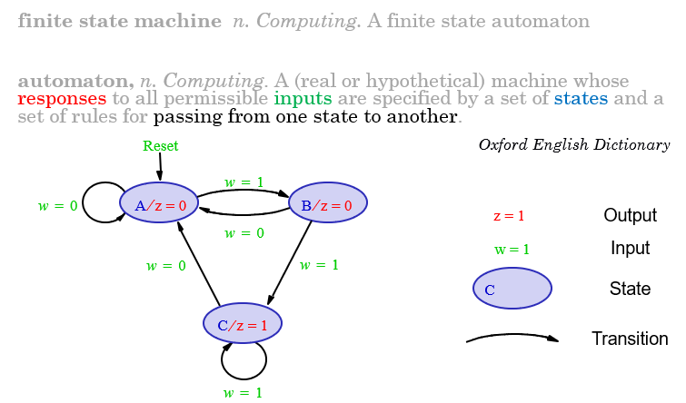
Finite State Machine Example

Slide 28
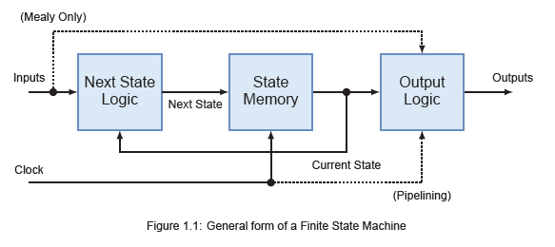
General Form of a Finite State Machine
Next state depends on Inputs
Moore Outputs Depend ONLY on the Present State
Mealy Outputs Depends on Present State AND current Inputs

Slide 29
Moore Finite State Machine Example
Next state depends on Inputs
Moore Outputs Depend ONLY on the Present State
Algorithm
When two consecutive inputs (w) are 1 the output (z) will be 1, otherwise zero
Step One
Draw state diagram of sequential circuit
Inputs illustrated on state transition.
Output illustrated within state.

Slide 30
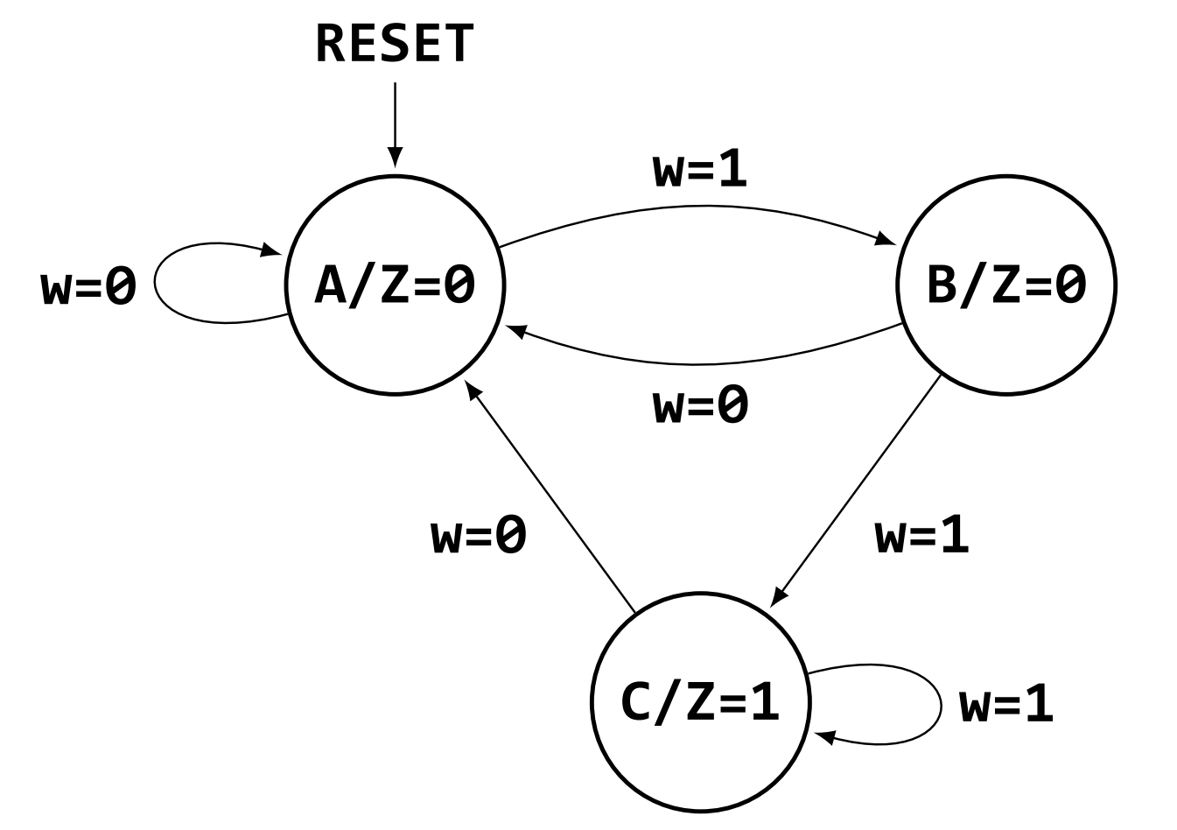
Moore Finite State Machine Example
Moore Outputs Depend ONLY on the Present State
Algorithm
When two consecutive inputs (w) are 1 the output (z) will be 1
Otherwise zero
Step One
Draw state diagram of sequential circuit
Inputs illustrated on state transition.
Output illustrated within state.

Slide 31
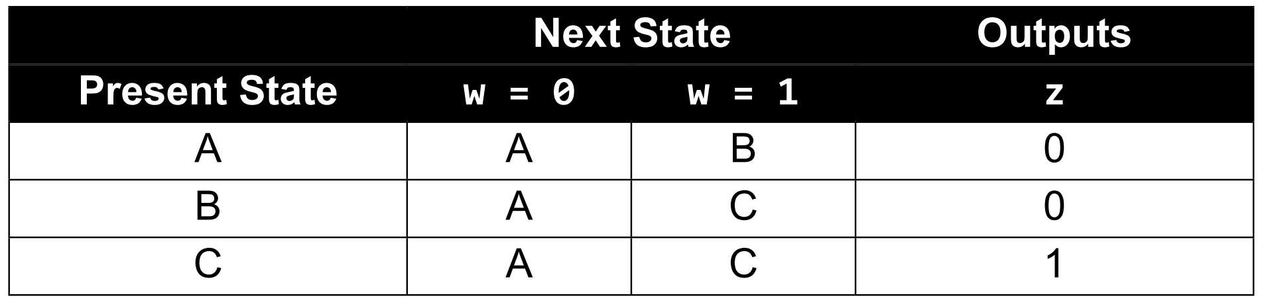
Moore Finite State Machine Example
Next state depends on Inputs
Moore Outputs Depend ONLY on the Present State
Step Two
Draw state table of sequential circuit

Slide 32
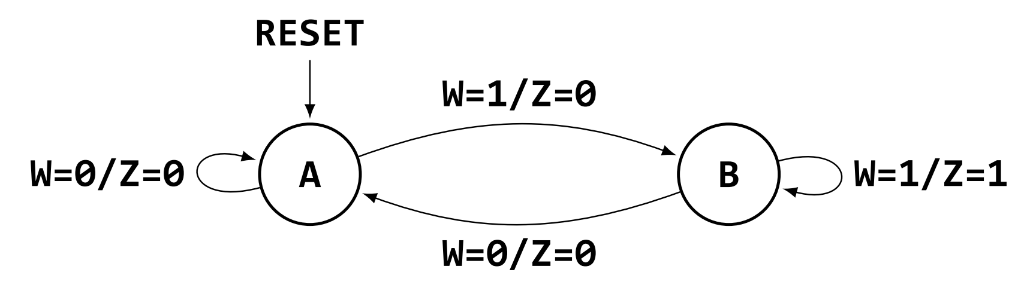
Mealy Finite State Machine Example
Next state depends on Inputs
Mealy Outputs Depends on Current State AND inputs
Algorithm
When two consecutive inputs (w) are 1 the output (z) will be 1
Otherwise zero
Step One
Draw state diagram of sequential circuit
Inputs AND outputs illustrated on state transition.

Slide 33
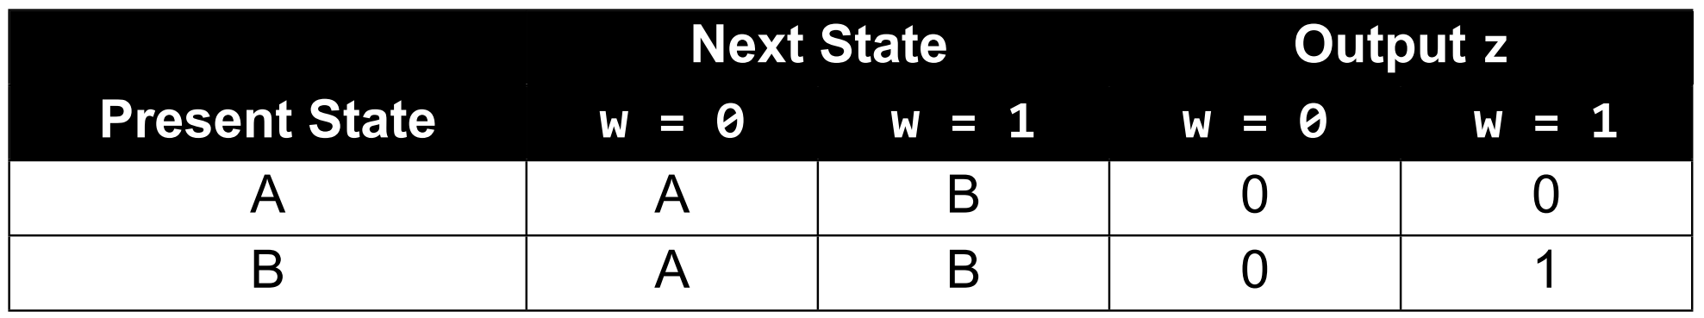
Mealy Finite State Machine Example
Next state depends on Inputs
Mealy Outputs Depends on Current State AND current inputs
Step Two
Draw state table of sequential circuit

Slide 34
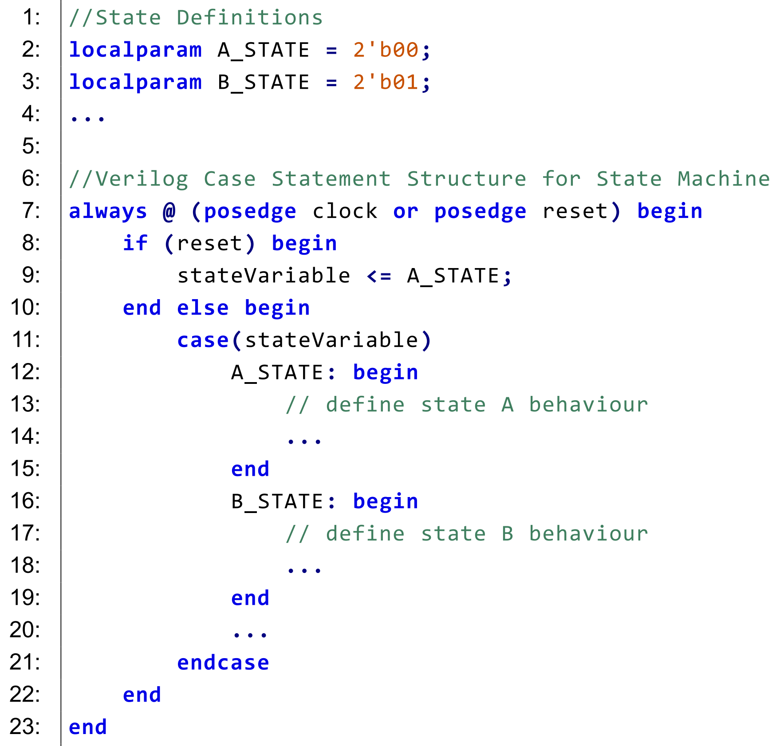
Generic Verilog State Machine Structure
Local parameters define states – each state encoded with an unique value
Reset code defines the starting state
Case statement – input of current state
Each state listed in case statement
Defines behaviour of each state

Slide 35
Moore State Machine Example

Slide 36
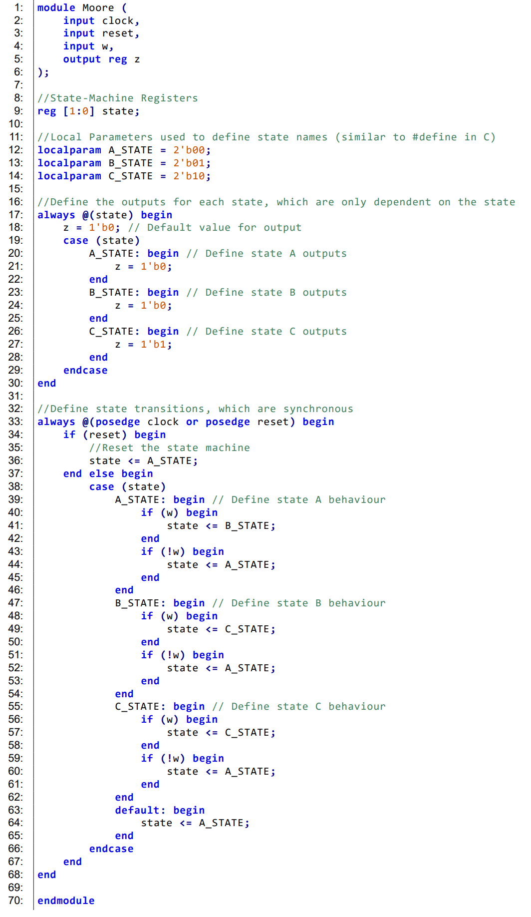
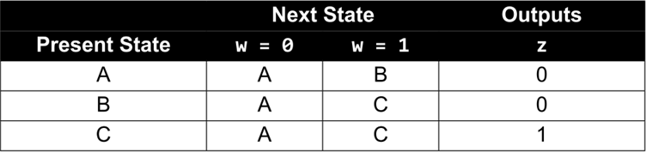
Verilog Code for Moore Example
Define clock and reset
Define input and output ports as per state table
Local parameters define states – each state encoded with an unique value

Slide 37
Verilog Code for Moore Example
Define outputs based on state as per state table.
Sensitivity list is state

Slide 38
Verilog Code for Moore Example
State transition sensitivity list based on clock and reset
Define state transitions based on input as per state table

Slide 39
Verilog Code for Moore Example
Define state transitions based on input as per state table
Define default state in case of error.
Useful when number of states is not equal to possible states in state variable.
e.g. 3 states using a 2 bit state variable
Erroneous state? state<= 2’b11;

Slide 40
Mealy State Machine Example

Slide 41
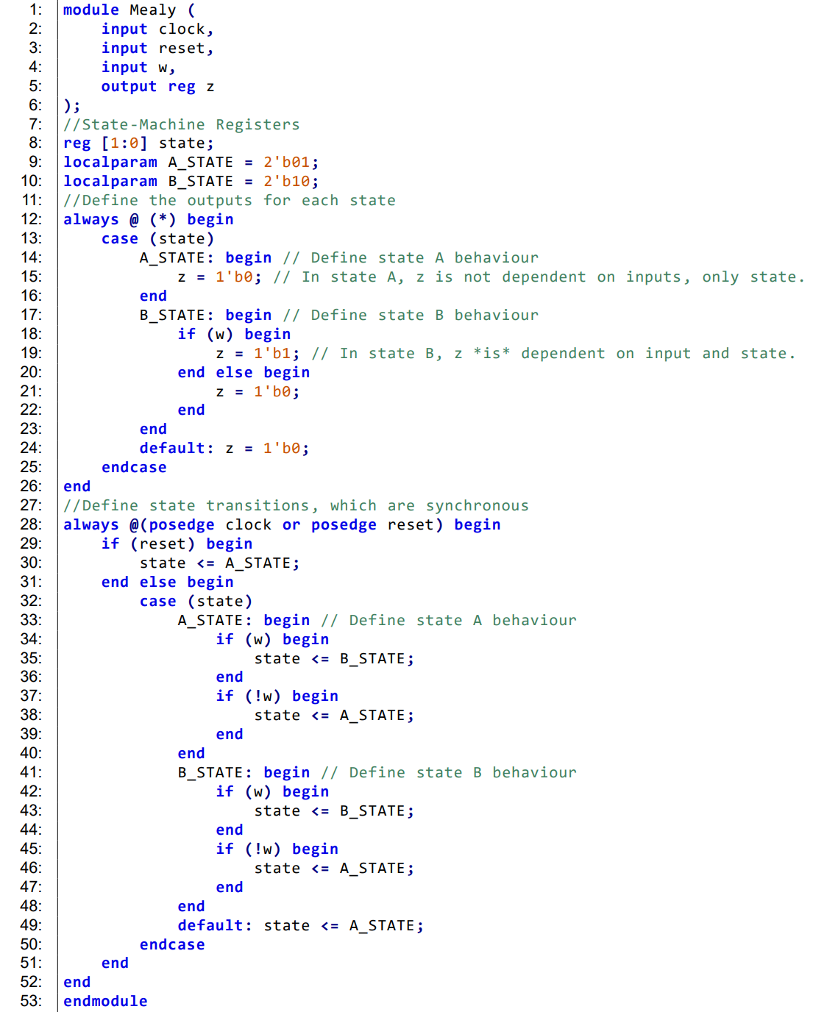
Verilog Code for Mealy Example
Difference to Moore:
In sensitivity list (*) wildcard
Output z depends on current input w
Notes:
In a Mealy machine, outputs, just like the transitions, can also be dependent on the inputs. As such, we must include any inputs that affect the output within the sensitivity list of the first alwaysblock or use the wildcard option (*)for simplicity

Slide 42
Verilog Code for Mealy Example
Define outputs based on state AND input as per state table.
Sensitivity list is (*) wildcard.
Notes:
In a Mealy machine, outputs, just like the transitions, can also be dependent on the inputs. As such, we must include any inputs that affect the output within the sensitivity list of the first alwaysblock or use the wildcard option (*)for simplicity

Slide 43
Verilog Code for Mealy Example
Define State Transitions based on inputs
Define default state in case of error.
Notes:
In a Mealy machine, outputs, just like the transitions, can also be dependent on the inputs. As such, we must include any inputs that affect the output within the sensitivity list of the first alwaysblock or use the wildcard option (*)for simplicity

Slide 44
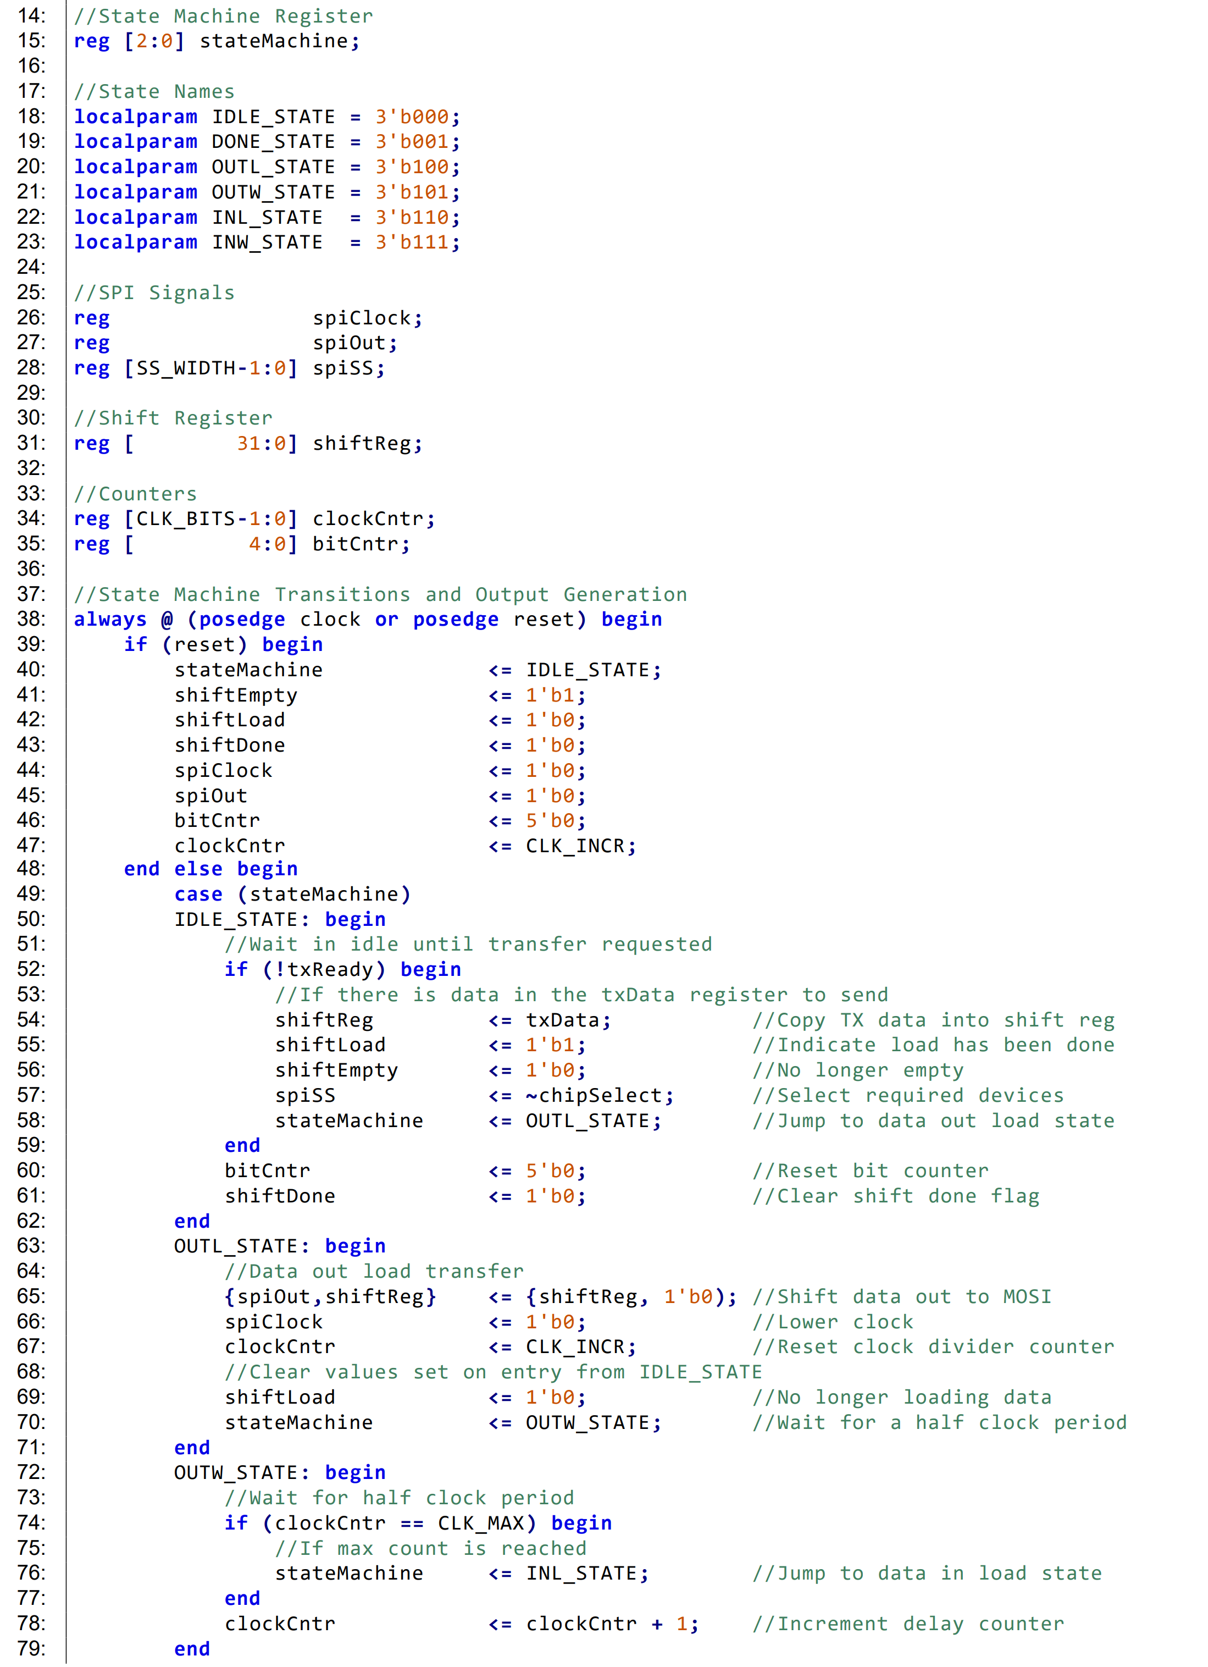
Hybrid State Machine Real world example
Hybrid State Machine:
State transitions and outputs controlled by same always block
Output can change in response to both inputs and current state, like a Mealy machine, however,
Outputs are synchronous to clock (with 1 cycle delay) like a Moore machine
Complex structures built into state machine such as counters

Slide 45
Hybrid State Machine Real world example
Hybrid State Machine:
State transitions and outputs controlled by same always block
Complex structure - Shift register
Complex structure - Counter

Slide 46
Questions

Slide 47
Have fun and enjoy the embedded modules!

